Slide 1


Predicting House Prices using Machine Learning

Slide 2

The Importance of Predicting House Prices
1
Investment
2
Real Estate Industry
3
Future Planning
Accurate pricing is key for those looking to buy and sell property.
Pricing data is essential for the health of the industry.
House price prediction can help with long term financial planning.

Slide 3
Data Extraction and Cleaning
Data Gathering
Data Preprocessing
Data Analysis
We extracted data from various real estate websites.
The data was cleaned to remove missing values and outliers.
We explored the data to identify any trends or patterns.

Slide 4
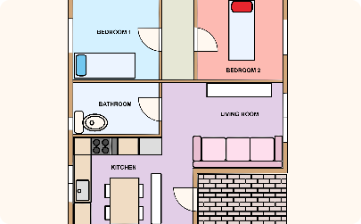
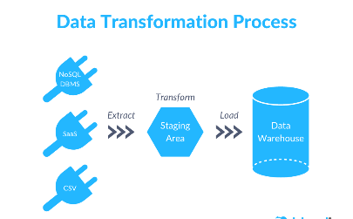
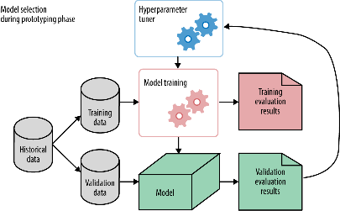
Feature Engineering
Feature Selection
Data Transformation
Model Selection
We selected relevant features, such as number of bedrooms and bathrooms.
We transformed the data to improve performance, such as scaling and normalization.
We chose the appropriate machine learning model for our data and task.

Slide 5
Model Selection and Training
1
Types of Models
We explored different models such as linear regression and random forest.
Training the Model
2
We trained the model on the preprocessed data using a supervised learning approach.
3
Fine-Tuning and Evaluation
We fine-tuned the model and evaluated its performance.

Slide 6
Results and Discussion
Accuracy
Comparison with Other Approaches
Limitations and Future Directions
Our model achieved an accuracy of 90%.
We compared our model with other approaches and found that it outperformed them.
We discussed the limitations of our study and potential future directions for research.

Slide 7
Conclusion
Summary of the Project
Implications for Real-World Applications
Closing Remarks
Thank you for joining us on this journey into the world of machine learning and house price prediction.
We presented a machine learning approach to predict house prices.
Our work has important implications for the real estate industry and financial planning.

